Slide 1


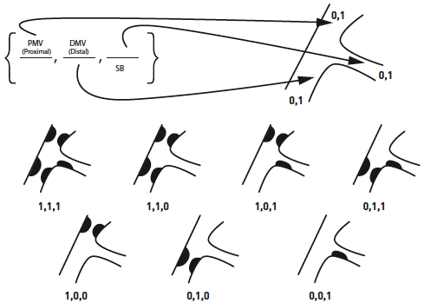

Left main coronary artery disease (old)
Figure 48
The MEDINA classification system for coronary bifurcations [203, 241]1 is used to indicate the presence of stenosis and 0 the absence of stenosis in each of the three segments. PMV: proximal main vessel; DMV: distal main vessel. - Reproduced with permission from Medina et al [65].
Rodrigo Modolo, Norihiro Kogame, Hidenori Komiyama, Vasim Farooq, Gregg W. Stone, Renu Virmani, Patrick W. Serruys, Alfonso Fernando
©2025 Europa Group - All rights reserved.

