Slide 1


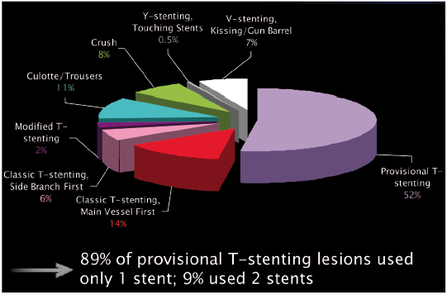

Left main coronary artery disease (old)
Figure 50
Left main distal (bifurcation) stenting techniquesLMS distal (bifurcation) stenting techniques (n=211) from the LMS PCI subset of the SYNTAX trial. Used with kind permission from the SYNTAX trial investigators [193].
Rodrigo Modolo, Norihiro Kogame, Hidenori Komiyama, Vasim Farooq, Gregg
W. Stone, Renu Virmani, Patrick W. Serruys, Alfonso Fernando
©2025 Europa Group - All rights reserved.

