Slide 1


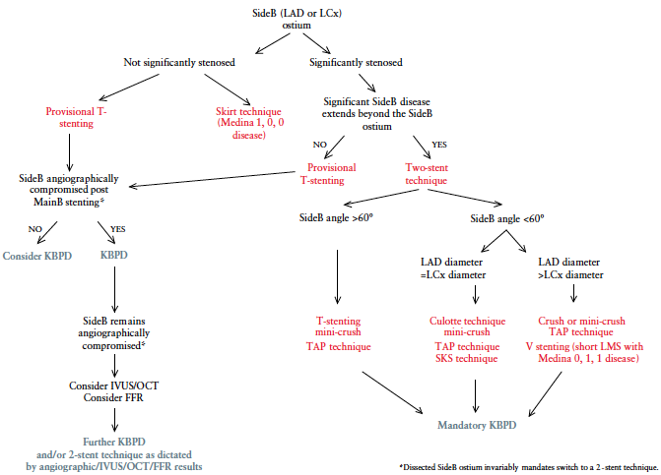

Left main coronary artery disease (old)
Figure 52
Simplified treatment algorithm to guide one or two-stent strategy in ULM PCI for bifurcation lesionsSideB is the smaller of the two vessels (predominantly but not exclusively the LCx).
Rodrigo Modolo, Norihiro Kogame, Hidenori Komiyama, Vasim Farooq, Gregg
W. Stone, Renu Virmani, Patrick W. Serruys, Alfonso Fernando
©2025 Europa Group - All rights reserved.

