Slide 1


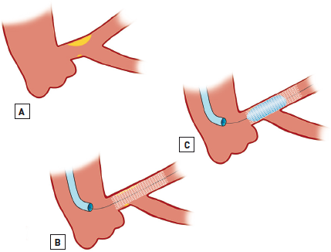

Left main coronary artery disease (old)
Figure 55A
Provisional T-stenting utilising the proximal optimisation technique (POT)Stenting of the MainB (in this example from LMS-LAD) is undertaken using a stent sized according to the distal vessel to reduce the likelihood of causing SideB (LCx) compromise (A-B). Post-dilatation using a short oversized balloon more proximally at the carina is undertaken next to expand the stent fully (C). This process produces curved expansion of the stent into the bifurcation and facilitates (distal) coronary wire recrossing. At this stage using the pullback technique of a curved wire from the distal MainB (LMS-LAD) can facilitate distal cell wire recrossing, which on subsequent KBPD leads to the ostial stent coverage of the SideB (D-F). Conversely, if the wire is passed more proximally, subsequent KBPD leads to a “floating” metallic neocarina (G-I) [156, 212].
Rodrigo Modolo, Norihiro Kogame, Hidenori Komiyama, Vasim Farooq, Gregg
W. Stone, Renu Virmani, Patrick W. Serruys, Alfonso Fernando
©2025 Europa Group - All rights reserved.

