Slide 1


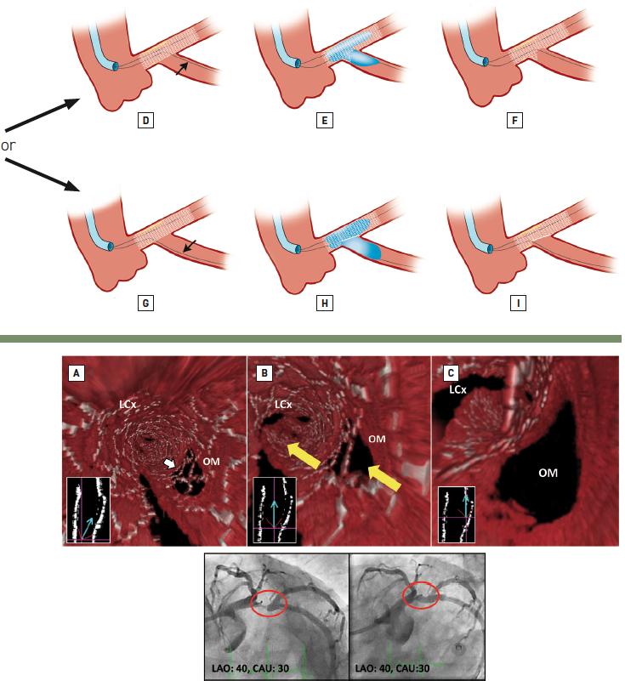

Left main coronary artery disease (old)
Figure 55B
3D-OCT demonstrating provisional T-stenting in a non-left main lesion to illustrate the principle of recrossing the coronary wire (after MainB stenting) into the SideB through the most distal cell. If this is not undertaken, a metallic “neocarina” is formed, as detailedProgressive downstream fly-through views culminating in the endoluminal point of view being located at the carina (A to C). White arrow indicates the most distal cell where it would be recommended the coronary wire be passed. Yellow arrows indicate the parallel courses of the left circumflex coronary artery (LCx) and obtuse marginal (OM) vessels at their point of divergence. Use the orientation figures in A-C to locate the endoluminal point of view (base of blue arrow). In this parallel bifurcation the struts located in front of the carina (A) are actually a prominent metallic extension of the carina and not covering the SideB opening (B-C). The potential to advance a coronary wire beneath the malapposed struts in the proximal vicinity of the ostial rim appears to be very real and, if SideB dilatation were performed, would result in multiple unappposed struts taking off from the carina. Corresponding coronary angiograms are illustrated below. Yellow arrows indicate the parallel origins of the LCx and OM vessels. Adapted and reproduced from Farooq et al [149].
Rodrigo Modolo, Norihiro Kogame, Hidenori Komiyama, Vasim Farooq, Gregg
W. Stone, Renu Virmani, Patrick W. Serruys, Alfonso Fernando
©2025 Europa Group - All rights reserved.

