Slide 1


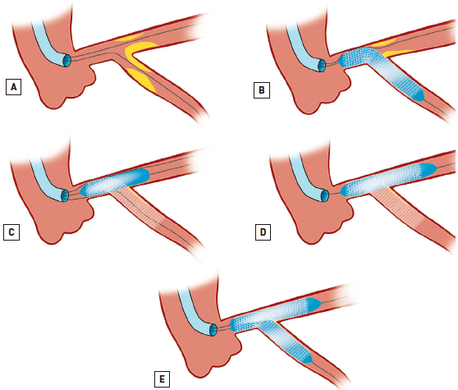

Left main coronary artery disease (old)
Figure 57
Culotte stenting(A) Wire both branches and predilate as necessary. (B) Leave the coronary wire in the straighter branch (usually the MainB: LMS-LAD) and deploy a stent in the more angulated branch (usually the SideB: LMS-LCx) jailing the LMS-LAD coronary wire. (C) Rewire the non stented LMS-LAD branch (consider performing intravascular imaging on the LMS-LCx coronary wire to ensure adequate stent expansion of the LMS portion of the LMS-LCx stent, in order to avoid inadvertent wire passage behind the LMS portion of the LMS-LCx stent when rewiring the LMS-LAD). Predilate the stent struts and the LMS portion of the LMS-LCx stent to ensure optimal expansion. (D) Remove the wire from the SideB (LMS-LCx). At this stage the jailed coronary wire in the LMS-LAD can be removed and a second stent deployed in the LMS-LAD with some proximal overlap with the LMS-LCx stent jailing the LMS-LCx coronary wire. (E) Recross the SideB (LMS-LCx) and perform KBPD.
Rodrigo Modolo, Norihiro Kogame, Hidenori Komiyama, Vasim Farooq, Gregg
W. Stone, Renu Virmani, Patrick W. Serruys, Alfonso Fernando
©2025 Europa Group - All rights reserved.

