Slide 1


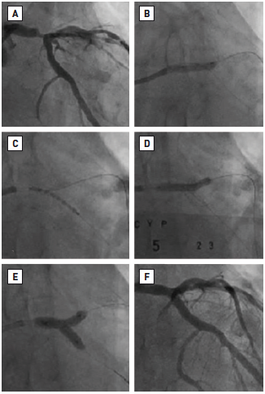

Left main coronary artery disease (old)
Figure 58
Culotte stenting(A) Initial appearance. (B) Predilatation of the LAD. (C) First stent deployed in the LCx. (D) Second stent deployed in the LAD after recrossing with wire and predilatation. (E) KBPD. (F) Final angiographic appearance. Reproduced with permission from Fajadet et al [233].
Rodrigo Modolo, Norihiro Kogame, Hidenori Komiyama, Vasim Farooq, Gregg W. Stone, Renu Virmani, Patrick W. Serruys, Alfonso Fernando
©2025 Europa Group - All rights reserved.

