Slide 1


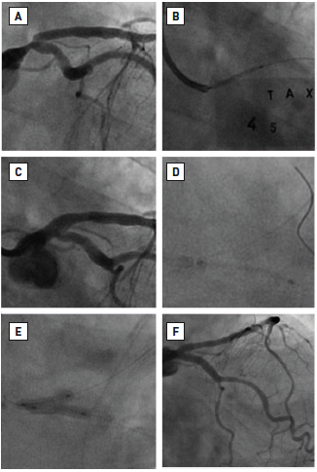

Left main coronary artery disease (old)
Figure 60
T-stenting(A) Initial appearance. (B) Stent deployment from LMS – LAD. (C) Dissection of ostial LCx. (D) Advancement of the stent into LCx. (E) KBPD. (F) Final angiographic appearance. Reproduced with permission from Fajadet et al [233].
Rodrigo Modolo, Norihiro Kogame, Hidenori Komiyama, Vasim Farooq, Gregg
W. Stone, Renu Virmani, Patrick W. Serruys, Alfonso Fernando
©2025 Europa Group - All rights reserved.

