Slide 1


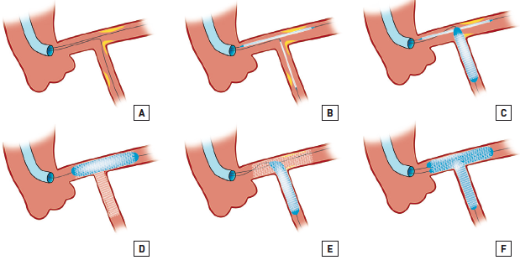

Left main coronary artery disease (old)
Figure 61
Modified T-stenting(A) Wire both branches and predilate if needed.(B) Advance the 2 stents, SideB stent positioned with minimal protrusion into MainB.(C) SideB stent deployed at nominal pressure.(D) Check for optimal result in the SideB and then remove balloon and wire from SideB. Deploy the MainB stent at high pressure.(E) Rewire the SideB stent and perform high pressure dilatation.(F) Perform final kissing inflation following advancement of a balloon into the MainB. Adapted from Latib et al [243].
Rodrigo Modolo, Norihiro Kogame, Hidenori Komiyama, Vasim Farooq, Gregg
W. Stone, Renu Virmani, Patrick W. Serruys, Alfonso Fernando
©2025 Europa Group - All rights reserved.

