Slide 1


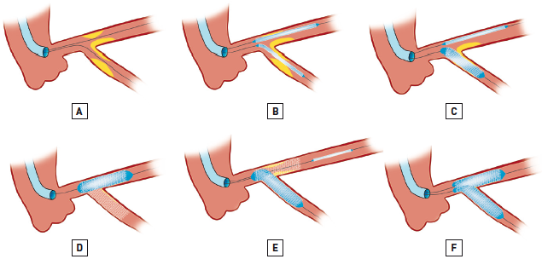

Left main coronary artery disease (old)
Figure 62
Mini-crush technique(A) Wire both branches and predilate as required.(B) Advance the 2 stents, with the MainB stent positioned more proximally (the MainB stent should be positioned more proximally than illustrated to ensure during deployment of the MainB stent it fully covers the section of the SideB stent in the MainB). The SideB stent minimally protrudes into the MainB.(C) Deploy the SideB stent.(D) Ensure optimal result in the SideB. Next remove the balloon and coronary wire from the SideB and deploy MainB stent.(E) Rewire the SideB and perform high pressure dilatation.(F) KBPD to finish.
Rodrigo Modolo, Norihiro Kogame, Hidenori Komiyama, Vasim Farooq, Gregg W. Stone, Renu Virmani, Patrick W. Serruys, Alfonso Fernando
©2025 Europa Group - All rights reserved.

