Slide 1


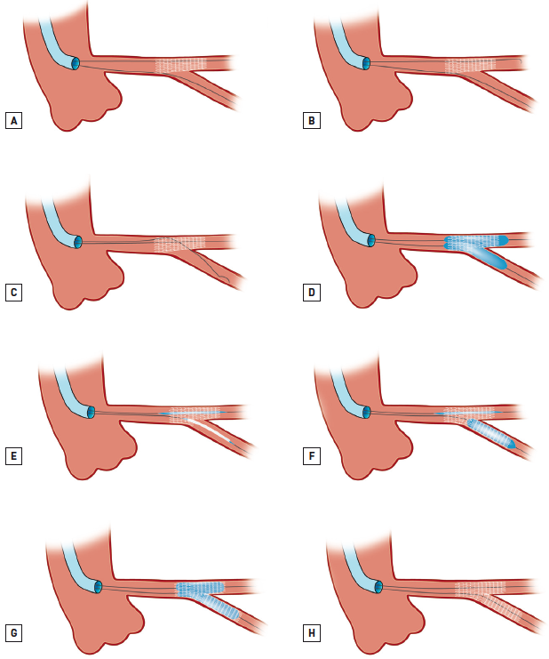

Left main coronary artery disease (old)
Figure 64
T-stenting and protrusion (TAP) technique(A) MainB and SideB are wired. Stent then deployed in MainB jailing the SideB wire. (B-C) Rewiring of SideB is performed using a “pullback” technique from the MainB (B). This ensures that the coronary wire would be more likely to pass through the distal cell of the SideB ostium (C). Jailed SideB wire withdrawn and passed into the MainB (C). (D) KBPD. (E) To stent the SideB (if required), a second stent is positioned in the SideB with an uninflated balloon in the MainB. Ensure minimal protrusion of the SideB stent into the MainB to limit size of the metallic neocarina (refer to Figure 70). (F) The SideB stent is deployed slightly protruding into the MainB. (G) The balloon of the SideB stent is slightly pulled back and aligned to the MainB balloon to perform KBPD. (H) Final result. Adapted from Burzotta et al [244, 245].
Rodrigo Modolo, Norihiro Kogame, Hidenori Komiyama, Vasim Farooq, Gregg W. Stone, Renu Virmani, Patrick W. Serruys, Alfonso Fernando
©2025 Europa Group - All rights reserved.

