Slide 1


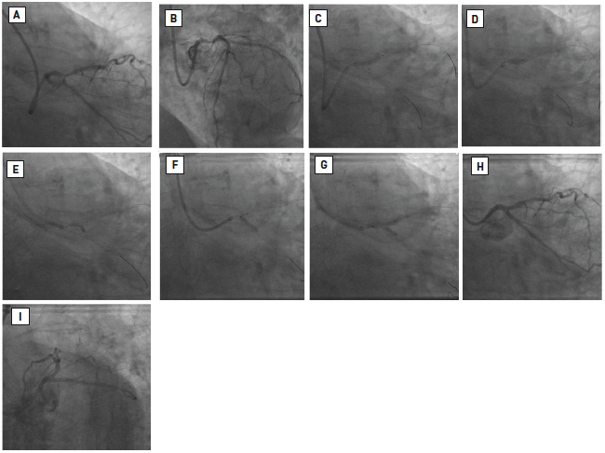

Left main coronary artery disease (old)
Figure 65
T-stenting and protrusion (TAP) technique(A-B) Initial appearances coronary: severe eccentric distal left main stenosis. (C-D) 3.5 x 18 mm DES implanted in LMS-LAD. Post-dilatation with a 4.0 mm balloon. (E) 2.5 mm balloon inflated in LMS-LCx through the stent struts. (F) 3.5 x 18mm DES deployed in LCx with proximal edge inside the LMS and a deflated 3.5 mm balloon in the LMS-LAD. (G) Final KBPD. (H-I) Final angiographic appearances. Reproduced with permission from Fajadet et al [233].
Rodrigo Modolo, Norihiro Kogame, Hidenori Komiyama, Vasim Farooq, Gregg W. Stone, Renu Virmani, Patrick W. Serruys, Alfonso Fernando
©2025 Europa Group - All rights reserved.

