Slide 1


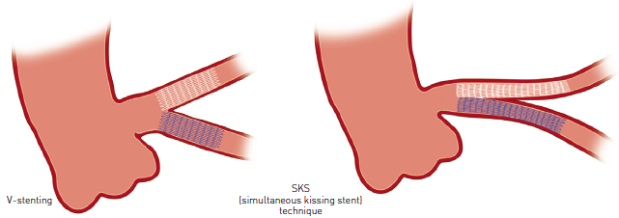

Left main coronary artery disease (old)
Figure 66B
Differences between V-stenting and SKS (simultaneous kissing stent) techniques
Rodrigo Modolo, Norihiro Kogame, Hidenori Komiyama, Vasim Farooq, Gregg W. Stone, Renu Virmani, Patrick W. Serruys, Alfonso Fernando
©2025 Europa Group - All rights reserved.

