Slide 1


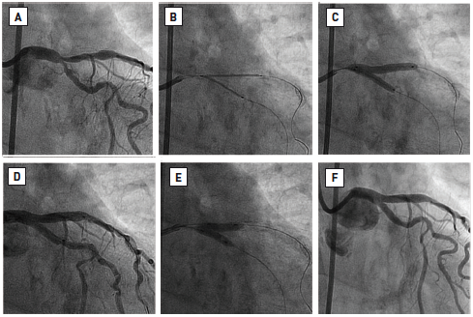

Left main coronary artery disease (old)
Figure 67
V-stenting(A) Initial appearance (Medina 0, 1, 1). (B) Two DES positioned in LAD and LCx up to both vessel ostia, so that the proximal edges of both stents are abutting each other in the most distal part of the LMS at the level of the carina. (C) Simultaneous implantation of both DES to equal pressures. (D) Intermediate result - post DES deployment. (E) KBPD. (F) Final angiographic appearance.Reproduced with permission from Fajadet et al [233].
Rodrigo Modolo, Norihiro Kogame, Hidenori Komiyama, Vasim Farooq, Gregg W. Stone, Renu Virmani, Patrick W. Serruys, Alfonso Fernando
©2025 Europa Group - All rights reserved.

