Slide 1


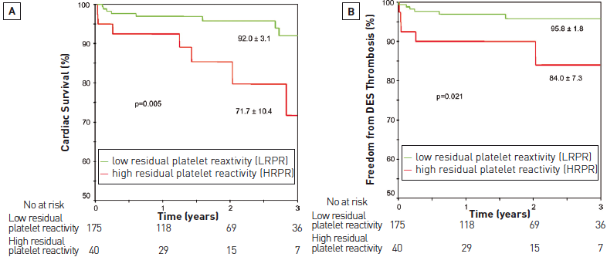

Left main coronary artery disease (old)
Figure 8
Clinical outcomes in the left main stratitifed by residual platelet reactivityKaplan-Meier analyses of cardiac survival (A) and stent thrombosis-free survival (B) for low residual platelet reactivity (LRPR) and high residual platelet reactivity (HRPR) groups are demonstrated. All patients (n=215) undergoing ULM PCI with DES prospectively underwent platelet reactivity assessments at least 12 hours after receiving a 600 mg loading dose of clopidogrel followed by their PCI procedure. Reproduced with permission from Migliorini et al [51].
Rodrigo Modolo, Norihiro Kogame, Hidenori Komiyama, Vasim Farooq, Gregg
W. Stone, Renu Virmani, Patrick W. Serruys, Alfonso Fernando
©2025 Europa Group - All rights reserved.

