Slide 1


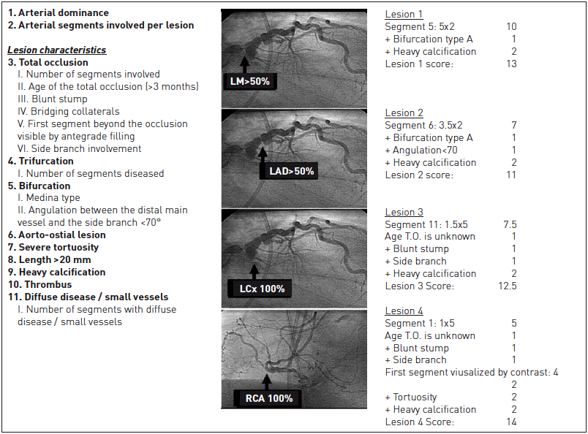

Left main coronary artery disease (old)
Figure 9
The SYNTAX score AlgorithmEach vessel segment, 1.5 mm in diameter or greater with a ≥50% diameter stenosis by visual estimation, is awarded a multiplication factor related to the location of the lesion and the severity of the stenosis. Further characterisation of the coronary lesions leads to the addition of more points as detailed. Within the case illustrated the total SXscore was 48.5. The information is entered into the online available SXscore algorithm which automatically sums each of these features to calculate the total SXscore. Adapted and reproduced with permission from Serruys et al [61].
Rodrigo Modolo, Norihiro Kogame, Hidenori Komiyama, Vasim Farooq, Gregg W. Stone, Renu Virmani, Patrick W. Serruys, Alfonso Fernando
©2025 Europa Group - All rights reserved.

