Slide 1


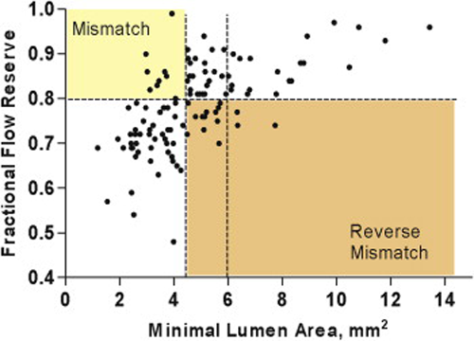

Left main coronary artery disease (old)
Figure e10
Scatter Plot of IVUS MLA Versus FFR using a cut-off MLA of 4.5mm2.MLA = minimal lumen area; FFR fractional flow reserve.Figure reproduced with permission from Park et al [262].
Rodrigo Modolo, Norihiro Kogame, Hidenori Komiyama, Vasim Farooq, Gregg W. Stone, Renu Virmani, Patrick W. Serruys, Alfonso Fernando
©2025 Europa Group - All rights reserved.

