Slide 1


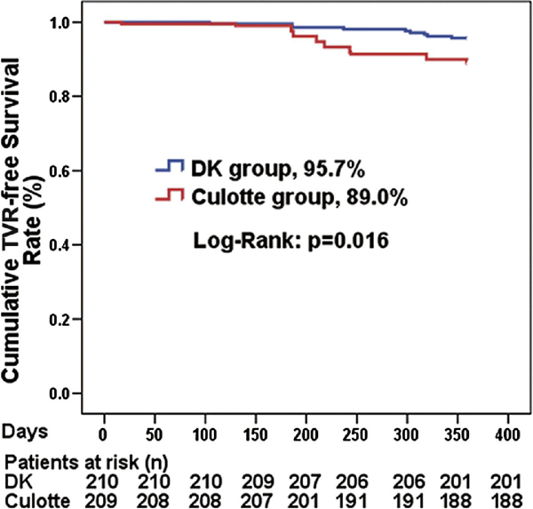

Left main coronary artery disease (old)
Figure e11b
TVR-free (89.0% vs. 95.7%, p=0.001) from the randomised DK-CRUSH-III study (culotte vs. double kissing group.Legend and figure adapted and reproduced with permission from Chen et al [268].
Rodrigo Modolo, Norihiro Kogame, Hidenori Komiyama, Vasim Farooq, Gregg
W. Stone, Renu Virmani, Patrick W. Serruys, Alfonso Fernando
©2025 Europa Group - All rights reserved.

