Slide 1


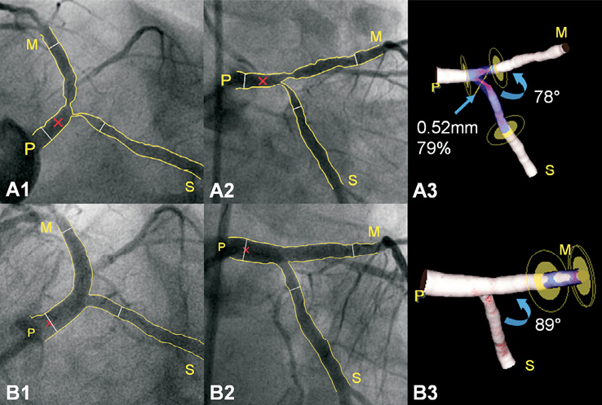

Left main coronary artery disease (old)
Figure e13
Three-dimensional reconstruction pre- and post-procedure utilising a Tryton bifurcation stent.A1-A2: A left and a right anterior oblique caudal view of a left main (0,1,1) bifurcation lesion are shown before stent placement; a Tryton stent will be placed from the proximal main vessel (P) into the side branch (S). Thin white lines demarcate the region of interest, whereas the red cross marks the common image point facilitating the 3-D reconstruction (A3); the most severe stenosis is located in the side branch ostium. B1-B3: Respective images post-procedure. Stenosis around the bifurcation is reduced, whereas minor obstruction is now located distal to the drug-eluting stent in the distal main vessel (M); PCI resulted in a slight increase in the 3-D distal bifurcation angle.Legend and figure reproduced with permission from Magro et al [273].
Rodrigo Modolo, Norihiro Kogame, Hidenori Komiyama, Vasim Farooq, Gregg W. Stone, Renu Virmani, Patrick W. Serruys, Alfonso Fernando
©2025 Europa Group - All rights reserved.

