Slide 1


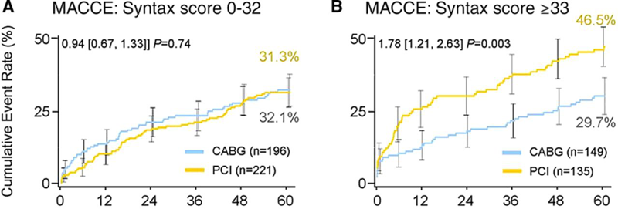

Left main coronary artery disease (old)
Figure e3
Five-year incidence of cardiac events in patients with (A) low and intermediate (0–32) and (B) high (≥33) Synergy Between PCI With Taxus and Cardiac Surgery (SYNTAX) scores from the left main cohort o f the SYNATX Trial.Hazard ratio and 95% confidence intervals are from the Cox partial likelihood method. Event rates are Kaplan-Meier estimates with a log-rank P value.Legend and figure adapted and reproduced with permission from Morice et al [250].
Rodrigo Modolo, Norihiro Kogame, Hidenori Komiyama, Vasim Farooq, Gregg
W. Stone, Renu Virmani, Patrick W. Serruys, Alfonso Fernando
©2025 Europa Group - All rights reserved.

