Slide 1


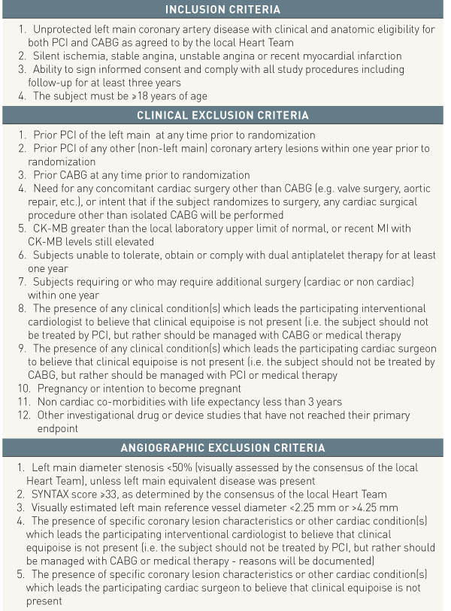

Left main coronary artery disease (old)
Table e1
Inclusion and Exclusion Criteria in the EXCEL randomized trial
Rodrigo Modolo, Norihiro Kogame, Hidenori Komiyama, Vasim Farooq, Gregg
W. Stone, Renu Virmani, Patrick W. Serruys, Alfonso Fernando
©2025 Europa Group - All rights reserved.

