Slide 1


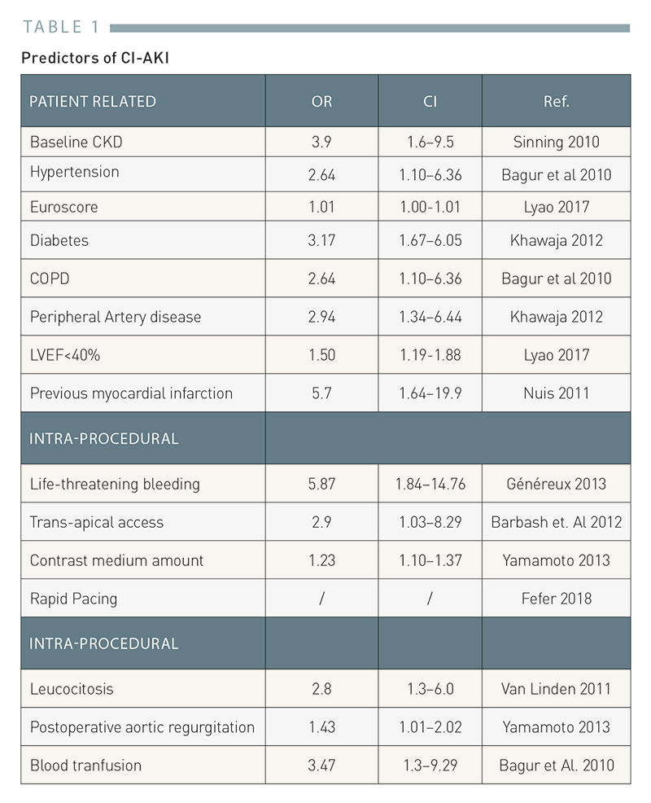
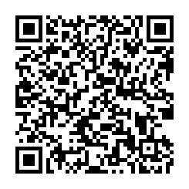
Lesion and patient subsets: chronic kidney disease (old)
Table 1
Predictors of CI-AKI in TAVI
Roberto Scarsini, Gabriele Pesarini, Flavio Ribichini
©2025 Europa Group - All rights reserved.

