Slide 1


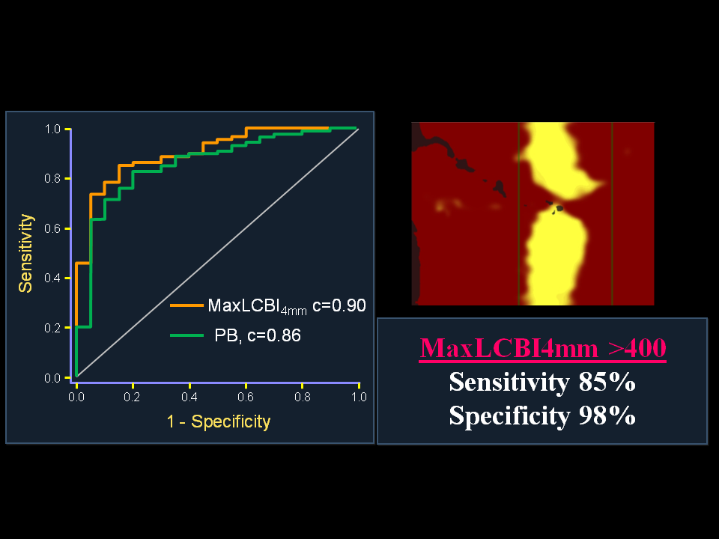

Near-infrared spectroscopy
Figure 10
ROC Analysis for Detection of STEMI Culprit Segments by NIRS and IVUS(A) The ability of NIRS and IVUS to distinguish culprit segments from nonculprit segments in the STEMI culprit vessel. MaxLCBI4mm(red), PB (green), and calcification (black) by IVUS are shown. MaxLCBI4mm was significantly more discriminatory than calcification (AUC: 0.90 vs. 0.72; p = 0.016) and performed similar to PB (AUC: 0.90 vs. 0.86; p = 0.44). (B) The ability of NIRS and IVUS to identify STEMI culprit segments when admixed with histology-negative autopsy specimens. MaxLCBI4mm(red), PB (green), and calcification (black) by IVUS are shown. MaxLCBI4mm was significantly more discriminatory at identifying STEMI culprit segments than were PB (AUC: 0.97 vs. 0.83; p = 0.015) or calcification (AUC: 0.97 vs. 0.79; p = 0.002). PB and calcification were not significantly different (p = 0.17). AUC = area under curve; ROC = receiver-operating curve; other abbreviations as in Figures 1, 2, and 4.
Jacob Goldstein, Salvatore Brugaletta, Sean P. Madden, Stephen T. Sum, Simon Dixon, Ryan D. Madder, Patrick W. Serruys, James E. Muller
©2025 Europa Group - All rights reserved.

