Slide 1


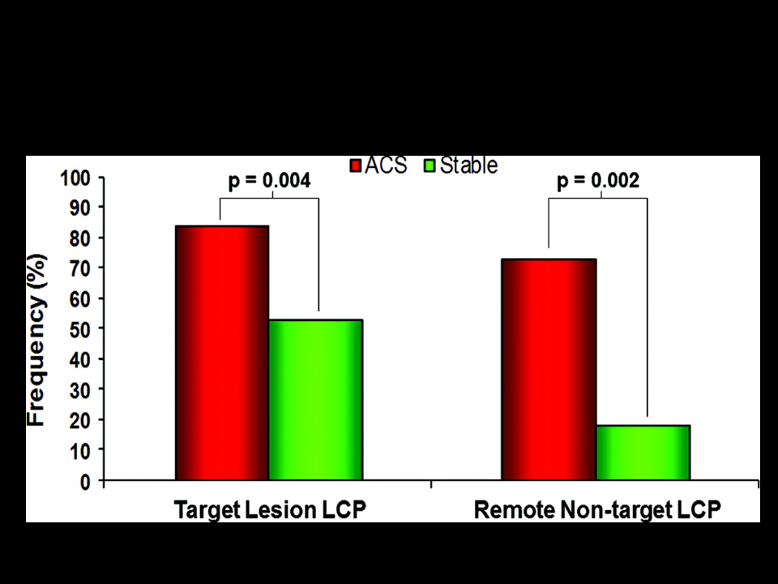

Near-infrared spectroscopy
Figure 11
Target and remote, non-target LCP by NIRS in patients with ACS and stable angina.The frequency of non-culprit LCP with the target vessel of patients with ACS and those with stable angina are shown. LCP=lipid-core plaques
Jacob Goldstein, Salvatore Brugaletta, Sean P. Madden, Stephen T. Sum, Simon
Dixon, Ryan D. Madder, Patrick W. Serruys, James E. Muller
©2025 Europa Group - All rights reserved.

