Slide 1


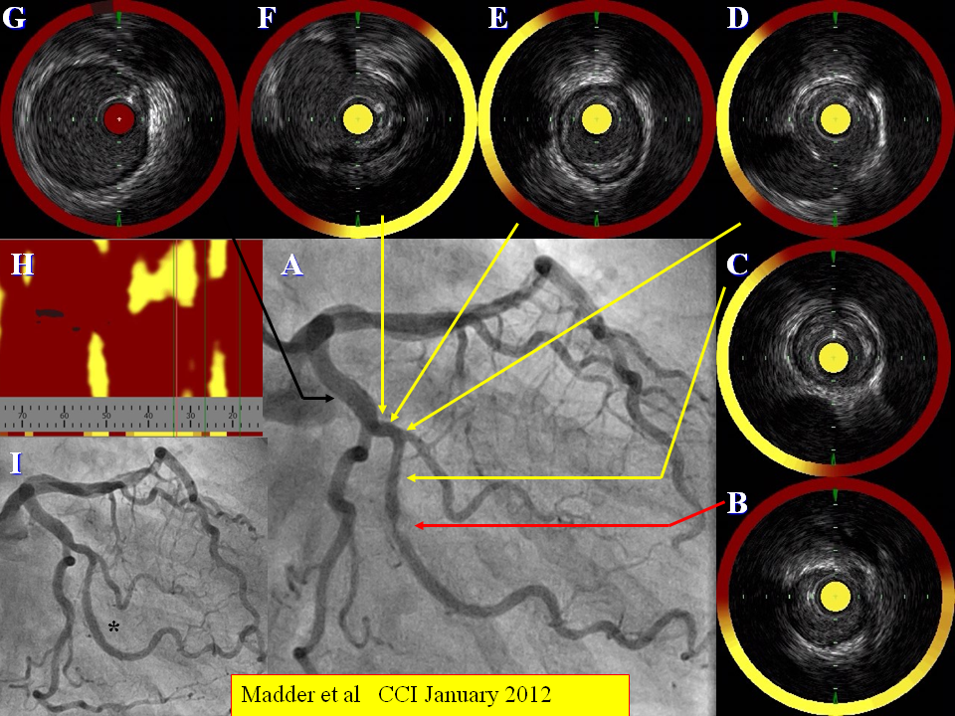

Near-infrared spectroscopy
Figure 4
Target lesion composition in a patient undergoing coronary angiography (A). A target stenotic lesion in the obtuse marginal branch of the circumflex artery shows evidence of a large burden of LCP (B) as does the proximal and distal coronary segments at sites of minor angiographic disease (C-G). This is summarised in the chemogram (H). The stenosis is stented subsequently (I). From Madder et al CCI January 2012
Jacob Goldstein, Salvatore Brugaletta, Sean P. Madden, Stephen T. Sum, Simon Dixon, Ryan D. Madder, Patrick W. Serruys, James E. Muller
©2025 Europa Group - All rights reserved.

