Slide 1


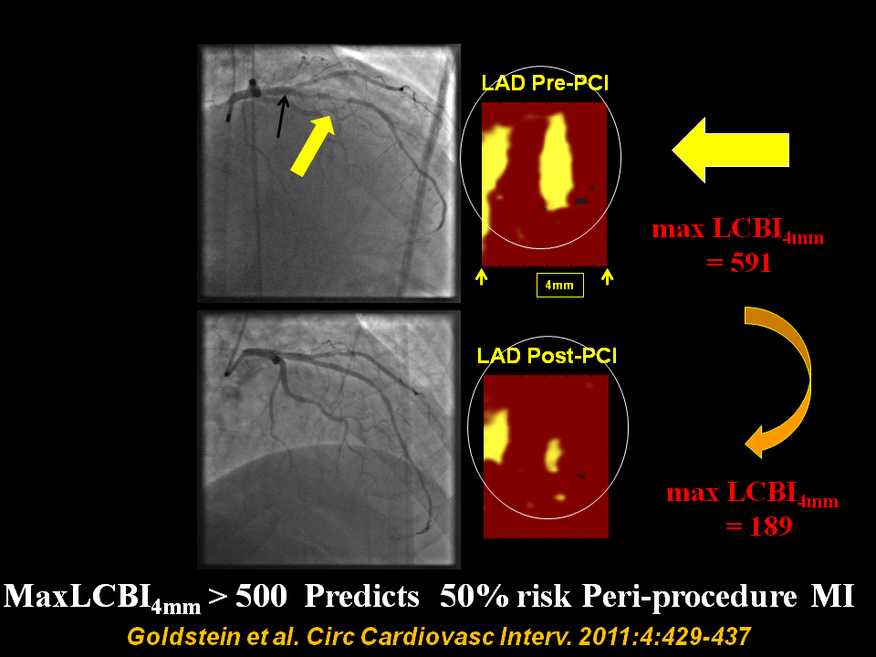

Near-infrared spectroscopy
Figure 5
Pre and post percutaneous coronary intervention (PCI) angiogram frames and chemograms for a patient experiencing a periprocedural myocardial infarction (MI)?Pre- and post-percutaneous coronary intervention (PCI) angiogram frames and chemograms for a patient having a periprocedural myocardial infarction (MI). The yellow and black arrows indicate the location on the angiogram of the proximal and distal boundaries of the PCI location and correspond to the boundaries of the chemogram segment. Pre-PCI maxLCBI4 mm was 591 at the region, indicated by the 4-mm mark. The post-PCI chemogram shows substantial reduction in lipid-core plaque (maxLCBI4 mm reduced to 189 in the matched region). LCBI indicates lipid-core burden index; LAD, left anterior descending artery. From Goldstein et al. Circ Cardiovasc Interv. 2011:4:429-437
Jacob Goldstein, Salvatore Brugaletta, Sean P. Madden, Stephen T. Sum, Simon Dixon, Ryan D. Madder, Patrick W. Serruys, James E. Muller
©2025 Europa Group - All rights reserved.

