Slide 1


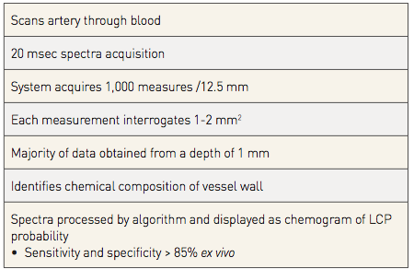
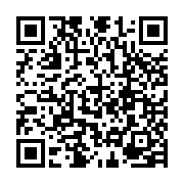
Near-infrared spectroscopy
Table 3
NIR spectroscopy
Jacob Goldstein, Salvatore Brugaletta, Sean P. Madden, Stephen T. Sum, Simon
Dixon, Ryan D. Madder, Patrick W. Serruys, James E. Muller
©2025 Europa Group - All rights reserved.

