Slide 1


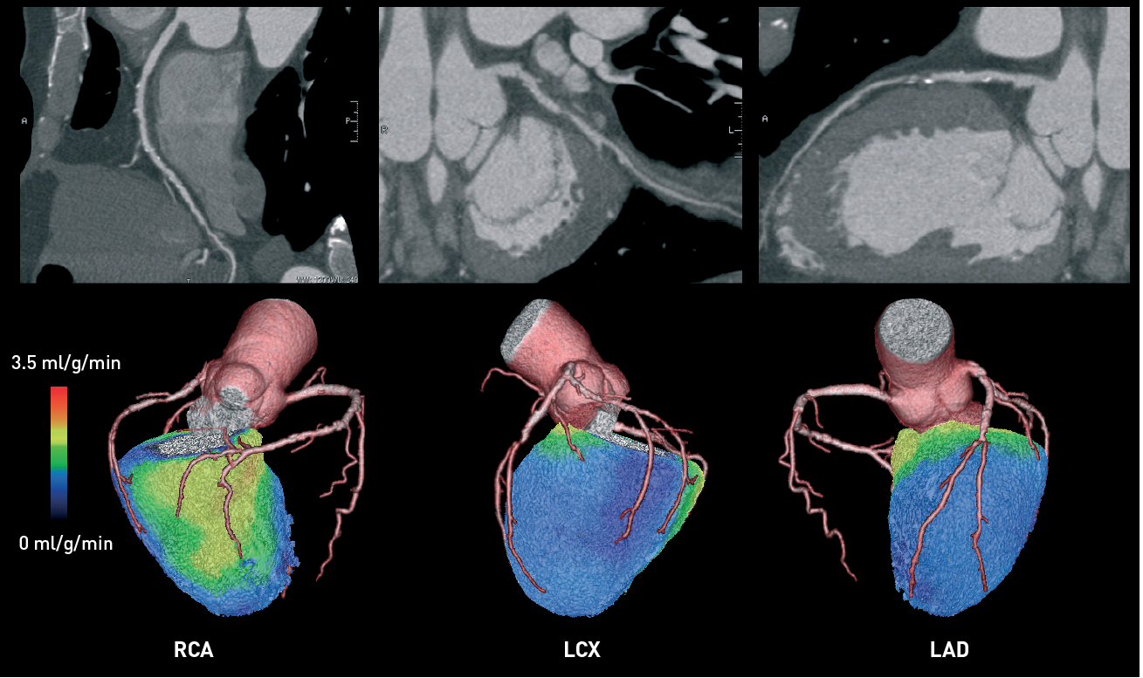

Non-invasive imaging for coronary disease
Figure 1
Hybrid PET-CTA imaging of CADA 57-year old man with atypical chest pain during exertion. Multi-planar CT reconstructions (upper row) show significant stenoses in the proximal left anterior descending (LAD) and proximal left circumflex (LCX) coronary arteries. The right coronary artery (RCA) shows eccentric calcification, but no stenosis. Hybrid volume-rendered images of CTA and myocardial perfusion during adenosine stress as assessed by 15O-labelled water PET are shown in the lower row. Stress myocardial perfusion was severely reduced as seen in blue colour (2.5 ml/g/min) in the RCA territory. The right coronary artery was not stenosed.
Juhani Knuuti, Philipp A. Kaufmann, Antti Saraste
©2025 Europa Group - All rights reserved.

