Slide 1


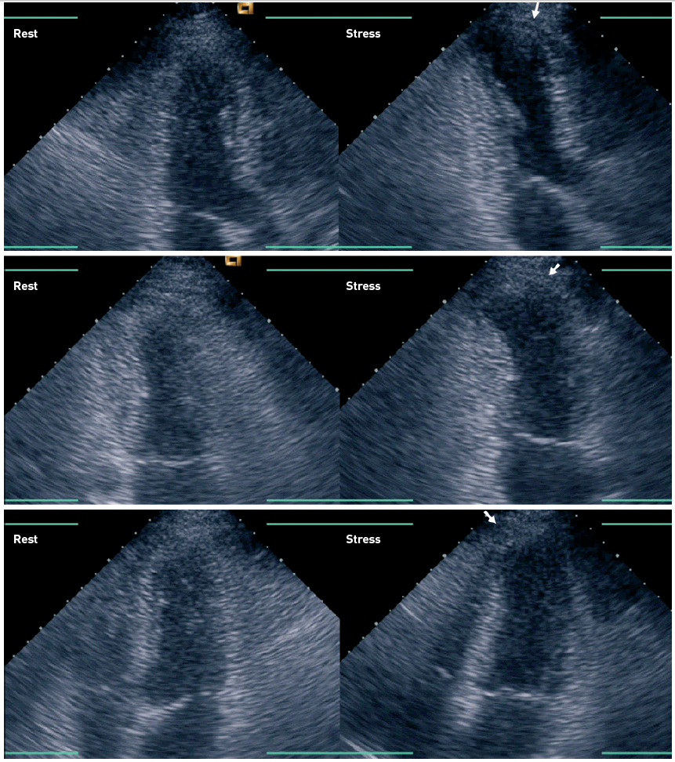

Non-invasive imaging for coronary disease
Figure 3
Stress echo in the detection of CADEnd-systolic apical long-axis (upper row), 2-chamber (middle row), and 4-chamber (lower row) images obtained at rest (left panels) and immediately after peak stress (right panels) in a patient undergoing exercise stress echocardiography. Note the lack of inward systolic motion in the anteroapical areas (arrows) at stress. The patient had atypical chest pain, positive stress ECG, and intermediate stenoses in both the left anterior descending (LAD) and left circumflex coronary arteries. Stress echocardiography confirmed the presence of ischaemia in the LAD coronary artery territory. See cine loops in the online data supplement.
Juhani Knuuti, Philipp A. Kaufmann, Antti Saraste
©2025 Europa Group - All rights reserved.

