Slide 1


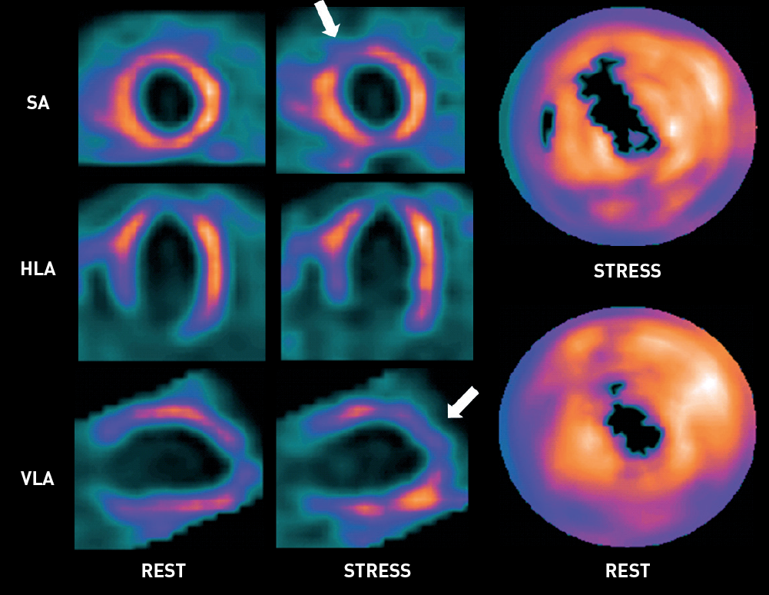

Non-invasive imaging for coronary disease
Figure 4
Myocardial perfusion 99mTc-sestamibi SPECT studyThe left column shows short axis (SA), horizontal long axis (HLA) and vertical long axis (VLA) images of myocardial perfusion at rest. The middle column shows corresponding stress images. Radiotracer was injected during peak treadmill exercise stress. Polar maps of radiotracer uptake in the left ventricular myocardium are shown in the right column. Note the apical perfusion defect in both rest and stress images indicating irreversible myocardial infarction. The perfusion defect extends into the anteroseptal area during stress (arrows), which is consistent with the presence of reversible myocardial ischaemia in this area.
Juhani Knuuti, Philipp A. Kaufmann, Antti Saraste
©2025 Europa Group - All rights reserved.

