Slide 1


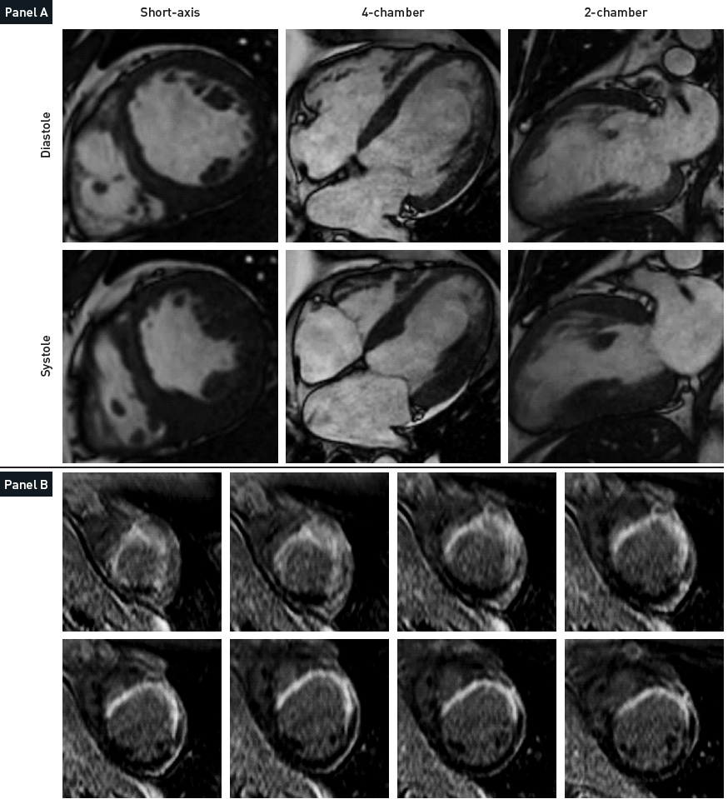

Non-invasive imaging for coronary disease
Figure 5
Stress CMRPanel A shows end-diastolic and end-systolic images of low-dose dobutamine cardiovascular MR study in a patient with anterior MI. Note apical myocardial thinning and the absence of systolic wall thickening in the myocardium supplied by the left anterior descending (LAD) coronary artery. The absence of improvement in wall motion or wall thickening in akinetic segments during low-dose dobutamine challenge indicated the presence of non-viable myocardium at the region of the LAD. Panel B shows late gadolinium enhancement cardiovascular MR study in a patient with a large anterior myocardial infarction. The image shows T1-weighed short axis images obtained at various levels of the left ventricle 10 minutes after injection of gadolinium. The hyper-enhanced infarcted area is transmural and appears brighter than the normal myocardium.
Juhani Knuuti, Philipp A. Kaufmann, Antti Saraste
©2025 Europa Group - All rights reserved.

