Slide 1


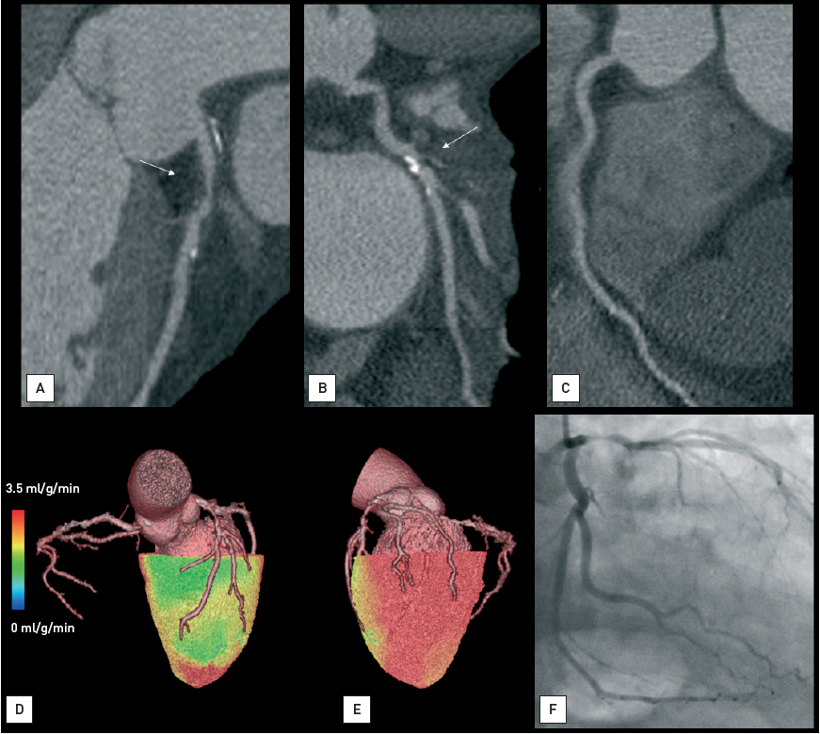

Non-invasive imaging for coronary disease
Figure 6
Hybrid PET-CTA imaging of CADA 66-year old man with hypercholesterolemia and type 2 diabetes. The patient presented with several months of transient, exercise-provoked chest pain. Rest ECG and echocardiography were normal. Exercise ECG showed mildly reduced exercise capacity, non-limiting chest discomfort and 0.1-0.15 mV ST-depression. Multiplanar CT reconstructions show significant luminal narrowing in the proximal left anterior descending (LAD, panel A) and calcified, probably obstructive lesion in the proximal left circumflex (LCX, panel B). The right coronary artery (RCA) shows no abnormality. Hybrid volume-rendered images of CTA and myocardial perfusion during adenosine stress as assessed by 15O–labelled water PET show moderately reduced perfusion in the myocardial region supplied by the LAD region as seen in green colour (average flow 2.0 ml/g/min, panel D). However, myocardial perfusion in the LCX region is normal as seen in red colour (average flow 3.4 ml/g/min, panel E). In line with this, invasive coronary angiography showed severe stenosis in the LAD, but only minimal narrowing in the LCX. The patient had successful percutaneous coronary intervention in the proximal LAD. See movie of hybrid image in the online data supplement.
Juhani Knuuti, Philipp A. Kaufmann, Antti Saraste
©2025 Europa Group - All rights reserved.

