Slide 1


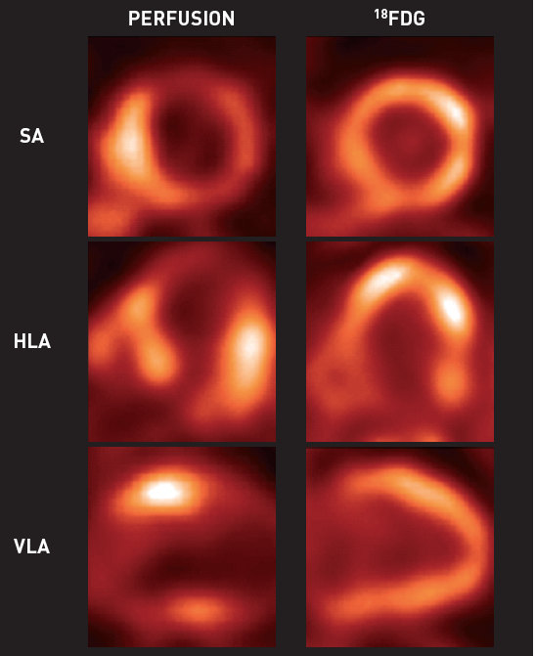

Non-invasive imaging for coronary disease
Figure 7
Assessment of myocardial viability by FDG PET: the flow-metabolism mismatchThe left column shows the resting short axis (SA), horizontal long axis (HLA) and vertical long axis (VLA) images of myocardial perfusion using 82Rubidium as the flow tracer. The corresponding FDG images are displayed in the right column. A large anterior and apical region with reduced perfusion was detected. However, in the FDG images the corresponding region had normal or even enhanced uptake of FDG as a marker of myocardial viability.
Juhani Knuuti, Philipp A. Kaufmann, Antti Saraste
©2025 Europa Group - All rights reserved.

