Slide 1


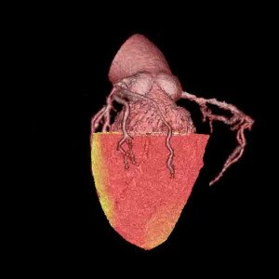

Non-invasive imaging for coronary disease
Movie 4
Hybrid volume-rendered movie of CTA and myocardial perfusion during adenosine stress as assessed by 15O –labelled water PET.
Juhani Knuuti, Philipp A. Kaufmann, Antti Saraste
©2025 Europa Group - All rights reserved.

