Slide 1


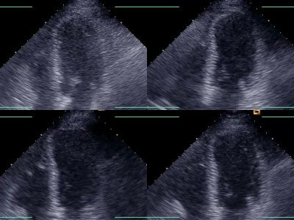

Non-invasive imaging for coronary disease
Moving image 1C
Am apical long-axis (Moving image 1A), 2-chamber (Moving image 1B), and 4-chamber (Moving image 1C) images obtained at rest (upper left panels), immediately after peak stress (upper right panels), at 3 minutes of recovery (lower left panels) and at 6 minutes of recovery (lower right panels) in a patient undergoing exercise stress echocardiography. Note the presence of akinesia in the anteroapical myocardium supplied by the LAD immediately after stress and gradual recovery of wall motion. The patient had atypical chest pain, positive stress ECG, and intermediate stenoses in both the left anterior descending (LAD) and left circumflex coronary arteries. Stress echocardiography confirmed the presence of ischaemia in the LAD coronary artery territory.
Juhani Knuuti, Philipp A. Kaufmann, Antti Saraste
©2025 Europa Group - All rights reserved.

