Slide 1


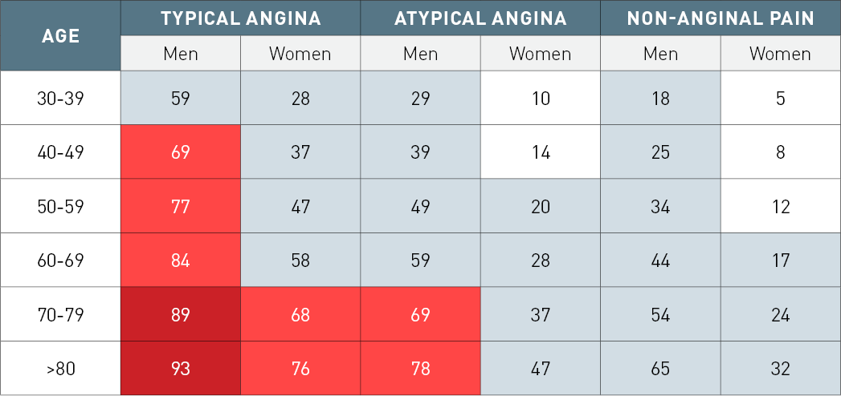

Non-invasive imaging for coronary disease
Table 1
Clinical pre-test probabilities of obstructive coronary artery disease in patients with stable chest pain syndromes. Adapted from Montalescot 2013 [1].Probabilities of obstructive coronary disease shown reflect the estimates for patients aged 35, 45, 55, 65, 75 and 85 years. Groups in white boxes have a positive pre-test probability (PTP) < 15% and hence can be managed without further testing. Groups in blue boxes have a PTP of 15–65%. They could have an exercise ECG if feasible as the initial test. However, if local expertise and availability permit a non-invasive imaging based test for ischaemia this would be preferable given the superior diagnostic capabilities of such tests. In young patients radiation issues should be considered. Groups in light red boxes have PTPs between 66–85% and hence should have a non-invasive imaging functional test for making a diagnosis of CAD. In groups in dark red boxes the PTP is > 85% and one can assume that CAD is present. They need risk stratification only
Juhani Knuuti, Philipp A. Kaufmann, Antti Saraste
©2025 Europa Group - All rights reserved.

