Slide 1


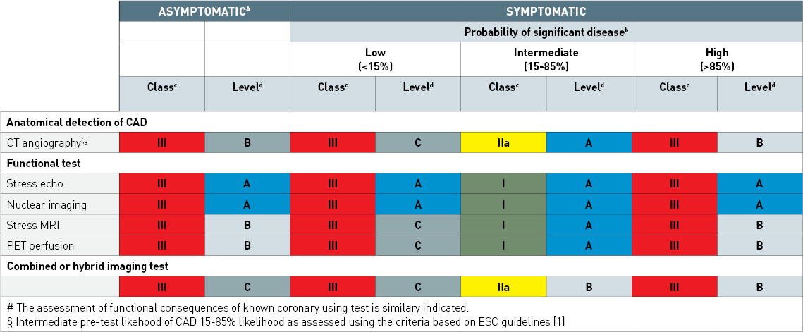

Non-invasive imaging for coronary disease
Table 2
The indications of different tests for the diagnosis of obstructive coronary artery disease and for the assessment of prognosis in the patients without known disease. Adapted from Windecker 2014 [2].
Juhani Knuuti, Philipp A. Kaufmann, Antti Saraste
©2025 Europa Group - All rights reserved.

