Slide 1


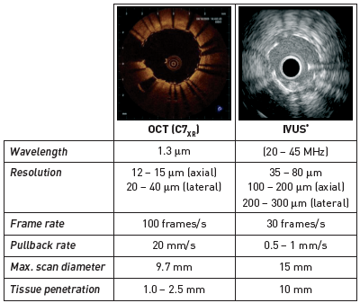

Optical coherence tomography (old)
Figure 1
Comparison of intracoronary Fourier domain OCT specifications and conventional intravascular ultrasound, as typically used in the catheterisation laboratory
* Based on specifications of the current generations of Volcano, Boston Scientific, and Terumo IVUS systems.
Francesco Prati, Flavio Giuseppe Biccirè
©2025 Europa Group - All rights reserved.

