Slide 1


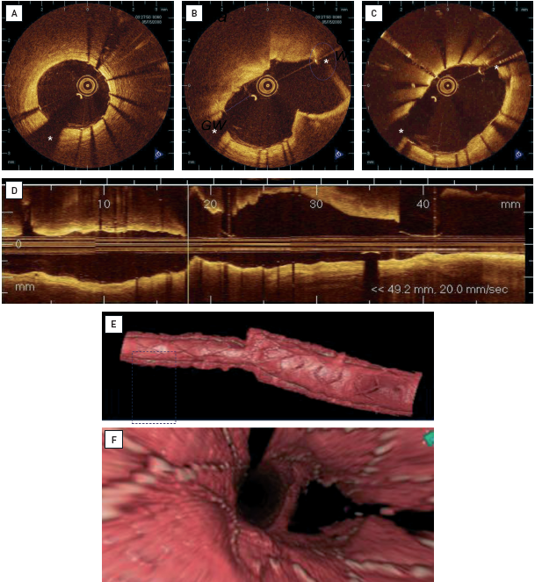

Optical coherence tomography (old)
Figure 10
Intracoronary OCT through the main vessel in a bifucation lesionTreatment with a dedicated bifurcation stent (Nile Croco®, Minvasys, Paris, France). (A) Distal stent portion with good stent expansion and well-apposed struts. (B) Carina is wide open and circumferentially covered by stent struts. The side branch is easily accessible and not jailed. Two guidewires can be recognised, as the side branch has also been wired. The Proximal stent portion, despite a big calibre difference as compared to the distal stent portion, again shows good stent expansion and well-apposed struts, jailed. (C) Two guidewires can be recognised, as the side branch has also been wired. (D) Longitudinal reconstruction of the pullback (left: distal; right: proximal) (E) 3D rendering of the OCT data. (F) En-face view from proximal to distal demonstrates the strut geometry at the carina. * indicates guidewire artefact.
Francesco Prati, Flavio Giuseppe Biccirè
©2025 Europa Group - All rights reserved.

