Slide 1


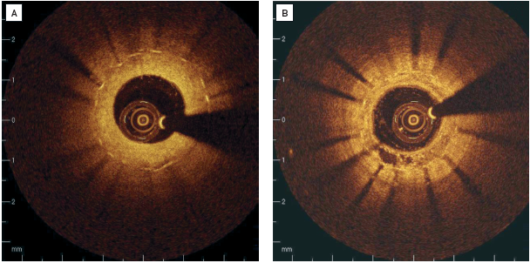

Optical coherence tomography (old)
Figure 11
Clinical examples of intracoronary OCT in patients with restenosis(A) Stent struts are covered with relatively thick, homogenous, signal rich tissue. (B) Covering of the stent struts is seen to be inhomogeneous, suggesting neovascularisation in 7 o’clock position. [OCT image source: St. Jude/LightLab Imaging C7XR]
Francesco Prati, Flavio Giuseppe Biccirè
©2025 Europa Group - All rights reserved.

