Slide 1

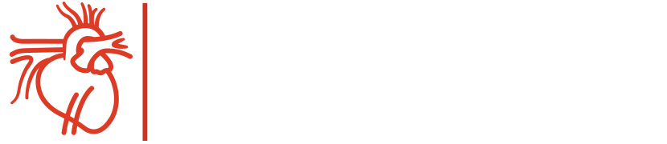
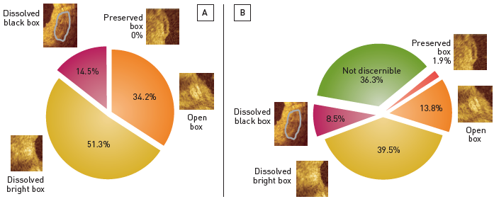
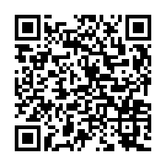
Optical coherence tomography (old)
Figure 13
Phenomenological description of in vivo strut morphology as observed in patients participating in the ABSORB Cohort A trial(A) At 6-month follow-up, the majority of struts can still be distinguished, with various optical patterns. (B) At 2-year follow-up, more than a third of the struts can not be optically distinguished from the vessel wall, suggesting complete bioresorption. [OCT: St. Jude/LightLab Imaging M3 & C7XR]
Francesco Prati, Flavio Giuseppe Biccirè
©2025 Europa Group - All rights reserved.

