Slide 1


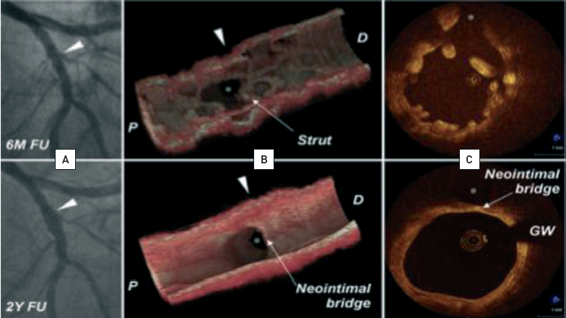
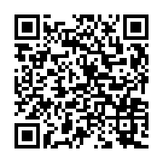
Optical coherence tomography (old)
Figure 14
Clinical example of serial OCT imaging in a patient participating in the ABSORB Cohort A trial(A) Coronary angiography; (B) 3D OCT rendering; (C) OCT cross-sectional view. OCT demonstrates strut changes over time. At two years, struts are not discernible from the vessel wall anymore, the side branch ostium is wide open and easily accessible.[Modified from Okamura et al Eur Heart J. 2010. OCT image source: St. Jude/LightLab Imaging M3 & C7XR]
Francesco Prati, Flavio Giuseppe Biccirè
©2025 Europa Group - All rights reserved.

