Slide 1


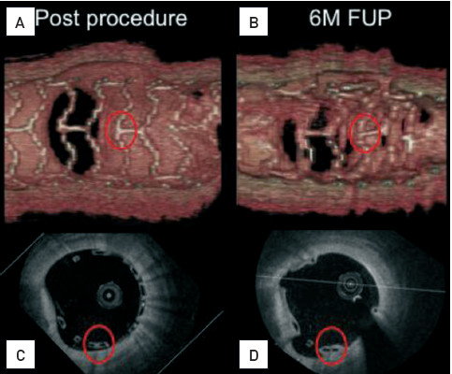

Optical coherence tomography (old)
Figure 15
Clinical example of serial OCT imaging in a patient participating in the ABSORB Cohort B trial(A) and (B) represent 3D reconstructions of the OCT pullback with a second generation, Fourier domain OCT system. The vessel is virtually cut open allowing assessment of the endoluminal part of the struts. Advances in OCT technology allow for better image quality and a detailed visualisation of the strut geometry at the carina of a side branch over time (A) at baseline (B) at 6-month follow-up. (C) Baseline cross-sectional OCT view revealing minimal strut malapposition in 6 o’clock position. (D) Follow-up cross-sectional OCT view demonstrating resolved strut malapposition in 6 o’clock position. Furthermore, the preservation of the box shape strut appearance can be appreciated. Such an in vivo imaging approach might be able to provide some information on the relationship between the mechanical integrity of the scaffold during its dissolution and resorption process.[OCT image source: Terumo prototype]
Francesco Prati, Flavio Giuseppe Biccirè
©2025 Europa Group - All rights reserved.

