Slide 1


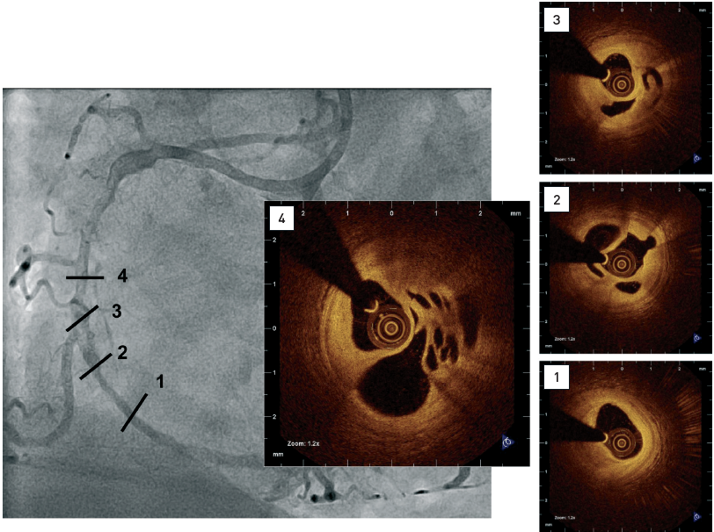

Optical coherence tomography (old)
Figure 16
Coronary angiogram showing diffuse disease including a complex hazy lesion(1-4) Intracoronary OCT confirming small lumen size, the presence of predominantly signal-rich, fibrous tissue and multiple channels.[OCT image source: St. Jude/LightLab Imaging C7XR]
Francesco Prati, Flavio Giuseppe Biccirè
©2025 Europa Group - All rights reserved.

