Slide 1


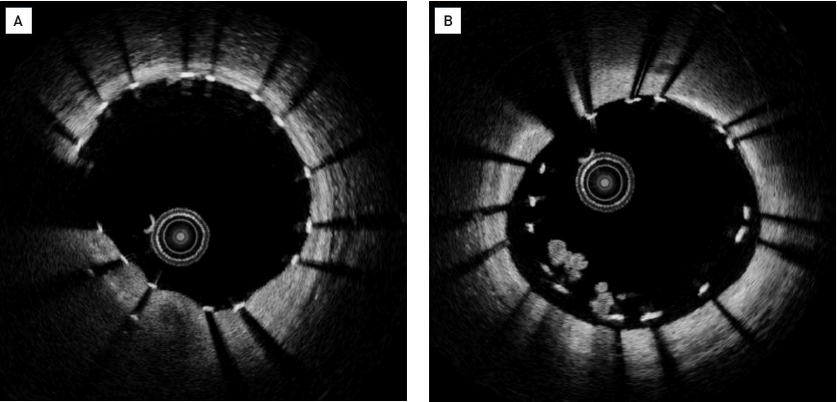

Optical coherence tomography (old)
Figure 17
Clinical examples for OCT findings immediately after stent implantation(A) Well-expanded stent with well-apposed stent struts. Metallic stent struts appear as highly scattering structures at the adluminal strut side and show a dorsal shadowing artefact as light can not penetrate the metal. (B) Indequate stent expansion with malapposition of the stent struts. There is intraluminal white thrombus visible in 7 to 8 o’clock position. [OCT image source: Terumo prototype]
Francesco Prati, Flavio Giuseppe Biccirè
©2025 Europa Group - All rights reserved.

