Slide 1


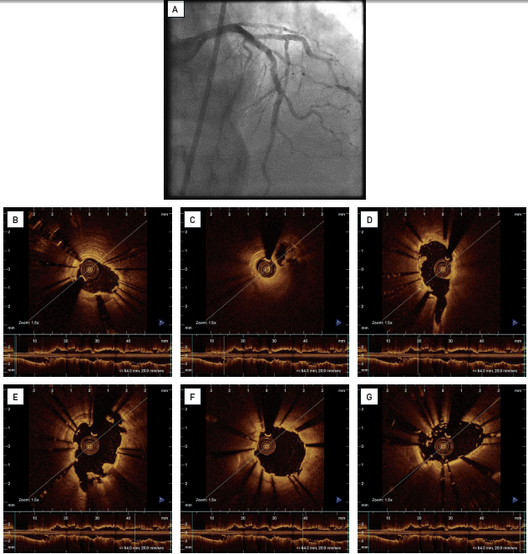

Optical coherence tomography (old)
Figure 19
Clinical example for OCT findings in patients with ambiguous angiographic culpritThe 82-year-old male was admitted for primary PCI with chest pain lasting 1 hour and ST elevation in anterior leads. Upon arrival in the catheterisationlaboratory, the patient was chest pain free and the ECG no longer showed signs of ischaemia. (A) Coronary angiogram of the left coronary system showed TIMI III flow, and considerable shadowing suggesting the presence of a coronary stent or severe calcification in the left anterior descending artery. (B-G) Intracoronary OCT in the left anterior descending artery visualised the presence of coronary stents. The sequence illustratesfindings from distal to proximal. (B-G) The stents are focally well-expanded and apposed against the vessel wall but also show regions with inadequately elliptically expanded stents (D, E, G), stent strut malapposition in a stent overlap zone (B), and the presence of sub-occlusive thrombus (B) and strut thrombosis (C-E). These findings suggest that stent thrombosis caused the acute coronary syndrome in our patient. Thrombus aspirationand balloon dilatations to correct stent expansion were successfully performed. [OCT image source: St. Jude/LightLab Imaging C7XR]
Francesco Prati, Flavio Giuseppe Biccirè
©2025 Europa Group - All rights reserved.

