Slide 1


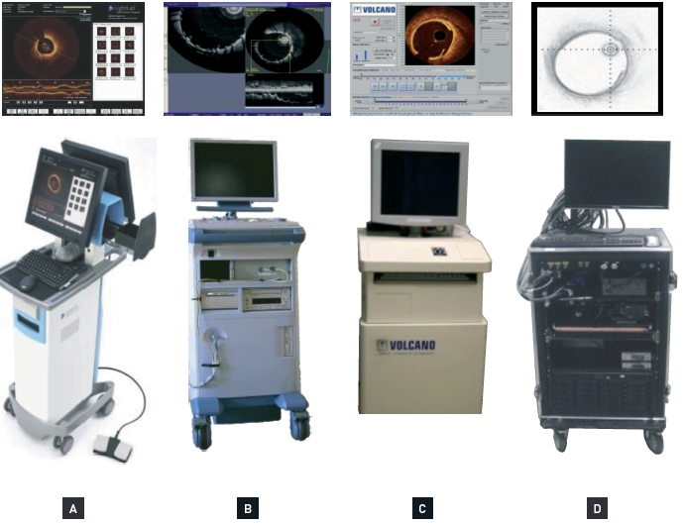

Optical coherence tomography (old)
Figure 2
Fourier domain OCT prototypes as utilised at the Thoraxcenter, Erasmus MC, the Netherlands, in 2008(A) St. Jude/LightLab Imaging Inc., Westford, MA, USA; (B) Terumo Corp., Tokyo, Japan; (C) Volcano Corp., Billerica, MA, USA; (D) MGH, G. Tearney & B. Bouma, Boston, MA, USA.
Francesco Prati, Flavio Giuseppe Biccirè
©2025 Europa Group - All rights reserved.

