Slide 1


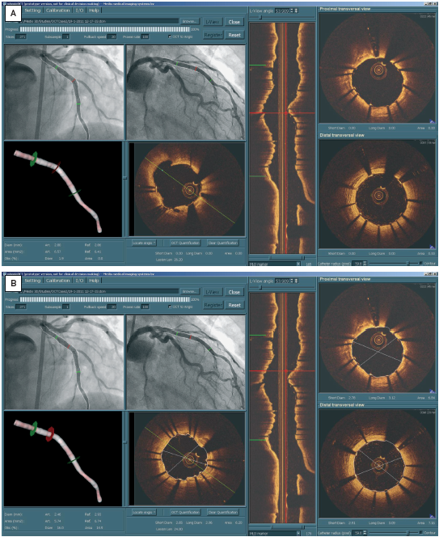

Optical coherence tomography (old)
Figure 20
Clinical example for co-registration of intracoronary OCT and angiography dataPoint-to-point correspondence between different views in the registration software. After the co-registration, markers which were superimposed onto the angiographic views and the OCT longitudinal view were synchronised. (A) In this case, the stent position (indicated by the proximal and distal green markers in the LAD) could be accurately mapped from the OCT image to the angiographic views. The OCT image at the LAD/diagonal bifurcation (indicated by the red marker) shows the opening of the diagonal branch. Comparison of 3D QCA with OCT assessments. The measurementsfrom the two imaging modalities could be compared at every corresponding position. (B) In this case, at the minimum lumen area position (indicated by the red marker above the diagonal branch), the short lumen diameter and area were 2.46 mm and 5.74 mm from 3D QCA, vs. 2.65 mm and 6.20 mm from OCT. [OCT image source: St. Jude/Lightlab Imaging C7XR]. The co-registration was performed by a recently developed software package (prototype version, Medis medical imaging systems bv, Leiden, The Netherlands).
Francesco Prati, Flavio Giuseppe Biccirè
©2025 Europa Group - All rights reserved.

