Slide 1


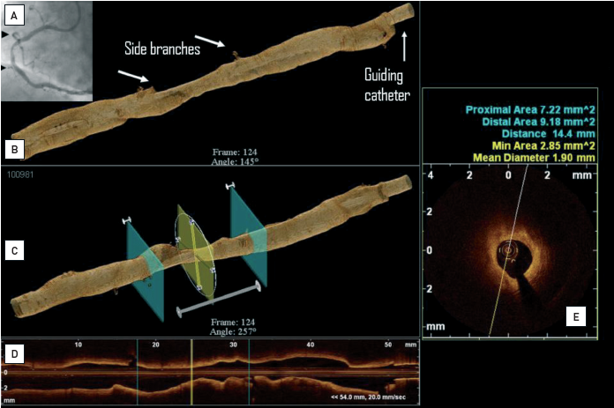

Optical coherence tomography (old)
Figure 21
Clinical example with online 3D rendering of the OCT data(A) Coronary angiogram of the right coronary artery. (B) Online, 3D lumen reconstruction of the imaged artery segment: side branches as well as the guiding catheter can easily be recognised and used as landmarks (LightLab/St. Jude prototype software, Westford, MA, USA). (C) Automated display of the minimal lumen area and proximal and distal reference segments. (D) 2D longitudinal view. (E) Cross-sectional view of the minimal lumen area.
Francesco Prati, Flavio Giuseppe Biccirè
©2025 Europa Group - All rights reserved.

