Slide 1


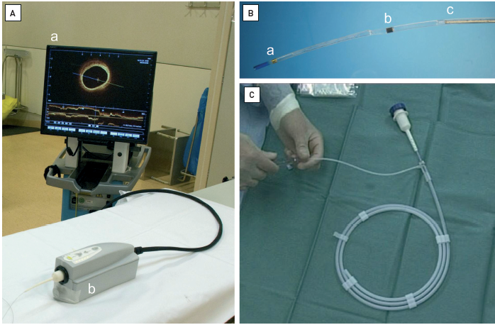

Optical coherence tomography (old)
Figure 3
Commercially available intracoronary Fourier domain OCT system(A) OCT system consisting of (a) console containing the light source, a computer and imaging display screen and (b) the automated pullback device allowing for pullback speeds up to 20 mm/sec; (B) OCT imaging catheter (Dragonfly™, LightLab Imaging Inc., Westford, MA, USA); magnification of the distal OCT catheter tip. The OCT imaging catheter is introduced into the coronary artery using a conventional guidewire in short monorail technique. The short monorail catheter segment is indicated by (a) the radiopaque distal catheter tip marker and (b) a more proximal radiopaque marker. (C) The imaging core is located approx 15 mm proximal to the distal tip marker and moderately radiopaque. During pullback, the imaging core is withdrawn within the transparent catheter sheath, while the OCT imaging catheter itself is stationary within the artery.
Francesco Prati, Flavio Giuseppe Biccirè
©2025 Europa Group - All rights reserved.

